Slide 1
RosettaCommons Code of Conduct
https://wiki.rosettacommons.org/index.php/Code_of_Conduct

Slide 2
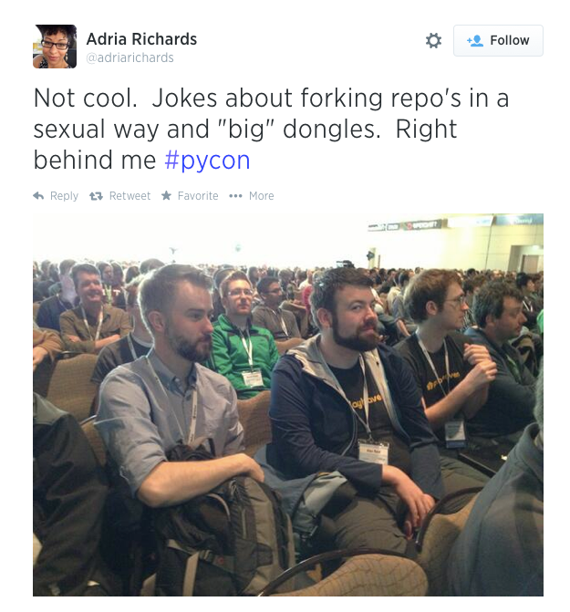
PyCon 2013

Slide 3
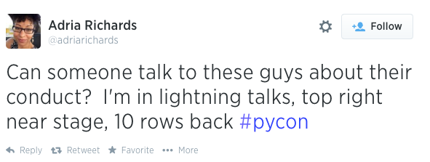
All three of these people were fired.
PyCon responded by drafting a code of conduct and making it editable by all attendees via GitHub
What a great idea!
https://wiki.rosettacommons.org/index.php/Code_of_Conduct

Slide 4
Short version
Be kind to, and mindful of, others. Do not insult or put down other attendees. Behave respectfully. Remember that harassment and bigoted (sexist, racist, homophobic, etc.) or exclusionary jokes are not appropriate for Rosetta conferences. Attendance at these conferences is a privilege, not a right.
We do not tolerate harassment of conference participants in any form.
https://wiki.rosettacommons.org/index.php/Code_of_Conduct

Slide 5
Short version
RosettaCon is dedicated to providing an inclusive and
harassment-free conference experience for everyone,
regardless of:
race or ethnicity
religion, or lack thereof
country of origin
level of intellect
language
age
sex
gender identity
sexual orientation
disability
physical appearance
body size
https://wiki.rosettacommons.org/index.php/Code_of_Conduct

Slide 6
If something happens:
speak up
If you need to report inappropriate behavior:
please find either Rebecca Alford or myself
https://wiki.rosettacommons.org/index.php/Code_of_Conduct

